Slide 1
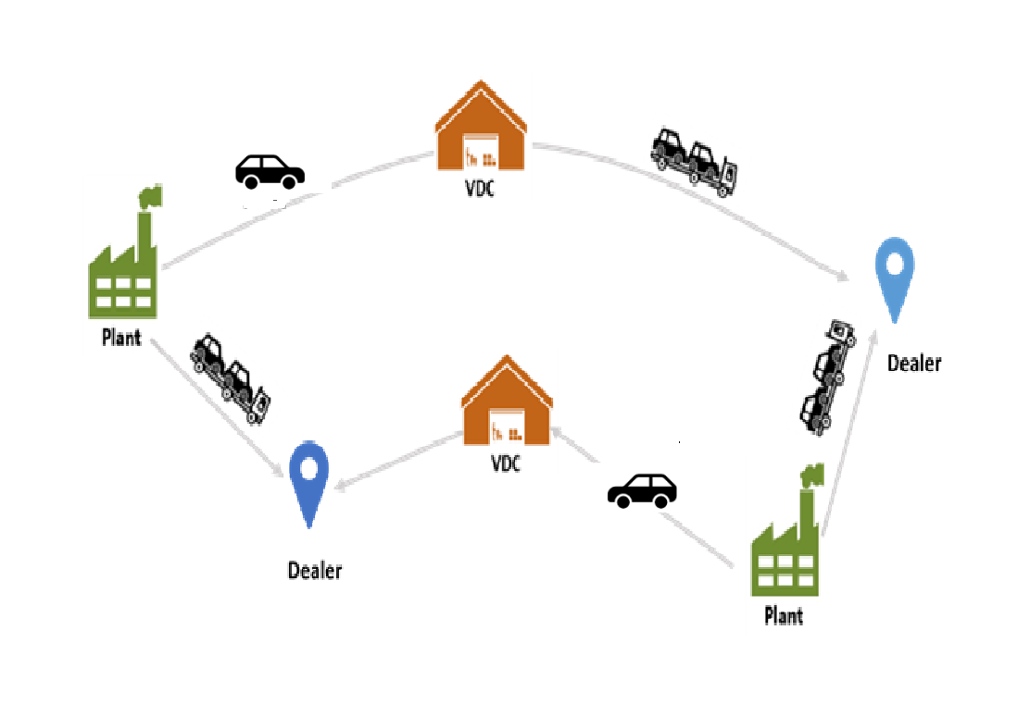
Informs: Redefining Vehicle Delivery with Autonomous Cars
Group Members: Lin, Manali, Kareem

Slide 2
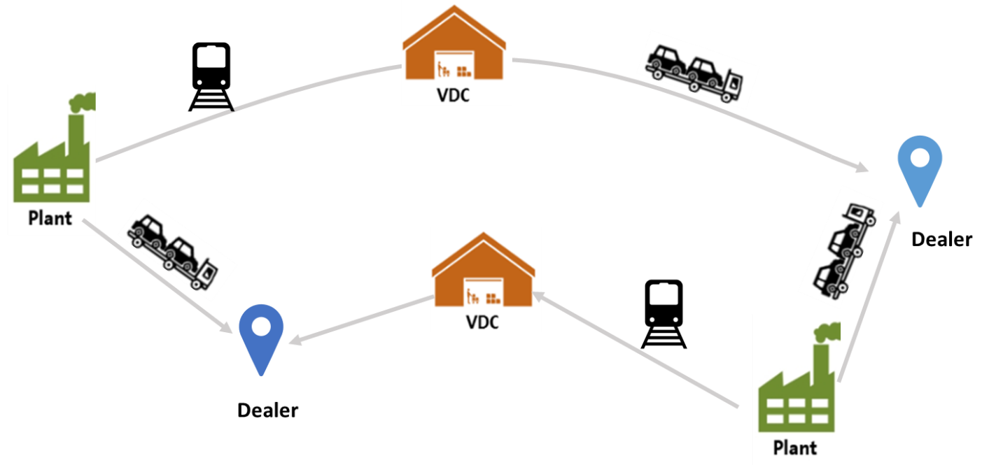
Problem Statement
Determine the lowest cost path from each plant to each dealer, given their locations, existing VDC locations, demand by each dealer, the cost of handling and transportation.
Sample for designing a solution:
Plants: 3A,FF.
Dealers : 21720, 21716.
VDC’s: 3F,4J,7J, 7M, BC.
Shipping Methods: AV and Truck.

Slide 3
Approach towards Solution
Understanding the objective, Decision Variables and Constraints
Data Exploration.
Segregating the VDC’s, Plants and Dealers from the given data.
Find the distance between the plant and dealers in order to compute the cost associated with the transport.
Formulating the Objective Function
Obtain Results

Slide 4
Can have supply demand and cost table and the distance table in this slide

Slide 5
Objective Function
min:
942.55 Q111 + 726.4 T111 + 891.95 Q121 + 689.6 T121 + 924.4 Q131 + 713.2 T131 + 974.45 Q141 + 749.6 T141 + 904.6 Q151 + 698.8 T151 + 567.45 Q211 + 453.6 T211 + 434.35 Q221 + 356.8 T221 + 450.3 Q231 + 368.4 T231 + 396.95 Q241 + 329.6 T241 + 940.35 Q251 + 724.8 T251 + 931.55 Q112 + 718.4 T112 + 1157.05 Q122 + 882.4 T122 + 993.15 Q132 + 763.2 T132 + 1099.3 Q142 + 840.4 T142 + 582.3 Q152 + 464.4 T152 + 556.45 Q212 + 445.6 T212 + 699.45 Q222 + 549.6 T222 + 519.05 Q232 + 418.4 T232 + 521.8 Q242 + 420.4 T242 + 618.05 Q252 + 490.4 T252;

Slide 6
Constraints:
Q111 + T111 + Q121 + T121 + Q131 + T131 + Q141 + T141 + Q151 + T151 = 212;
Q211 + T211 + Q221 + T221 + Q231 + T231 + Q241 + T241 + Q251 + T251 = 90;
Q112 + T112 + Q122 + T122 + Q132 + T132 + Q142 + T142 + Q152 + T152 = 14;
Q212 + T212 + Q222 + T222 + Q232 + T232 + Q242 + T242 + Q252 + T252 = 40;
TT111 = 0.1 T111; TT121 = 0.1 T121;
TT131 = 0.1 T131;TT141 = 0.1 T141;
TT151 = 0.1 T151;TT211 = 0.1 T211;
TT221 = 0.1 T221;TT231 = 0.1 T231;
TT241 = 0.1 T241;TT251 = 0.1 T251;
TT112 = 0.1 T112;TT122 = 0.1 T122;
TT132 = 0.1 T132;TT142 = 0.1 T142;
TT152 = 0.1 T152;TT212 = 0.1 T212;
TT222 = 0.1 T222;TT232 = 0.1 T232;
TT242 = 0.1 T242;TT252 = 0.1 T252;
int TT111, TT121, TT131, TT141, TT151, TT211, TT221, TT231, TT241, TT251, TT112, TT122, TT132, TT142, TT152, TT212, TT222, TT232, TT242, TT252;

Slide 7
Result:

